Slide 1

ROCKBUSTER STEALTH DATA ANALYSIS
Neha tailor

Slide 2
Introduction
Rockbuster Stealth LLC is a movie rental company.
Currently facing stiff competition from streaming service such as Netflix and Amazon Prime.
Plan is to use existing movie licenses to launch an online video rental service in order to stay competitive.

Slide 3
Key Questions & Objectives
What we need know to aid the launch strategy for the new online video service.
Which movies contributed the most/least to revenue gain?
What was the average rental duration for all videos?
Which countries are Rockbuster customer based in?
Where are customers with a high lifetime value based?
Do sales figures vary between geographic regions?

Slide 4

Minimum, Maximum & Average
Here we look at the values for the following sets of data that are adequate for achieving the launch strategy.
RENTAL (COST $)
MIN – 0.99
MAX – 4.99
AVG – 2.98
LENGTH (OF FILM IN MINS)
MIN - 46
MAX - 185
AVG – 115.272
RENTAL DURATION
MIN – 3
MAX – 7
AVG – 4.985
REPLACEMENT COST ($)
MIN – 9.99
MAX – 29.99
AVG – 19.984

Slide 5
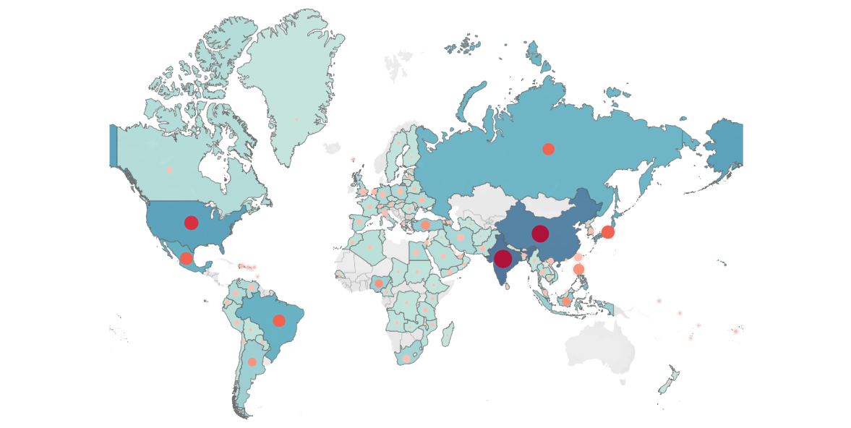

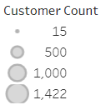
Where Are Rockbuster Stealths’ Customers based?

Slide 6
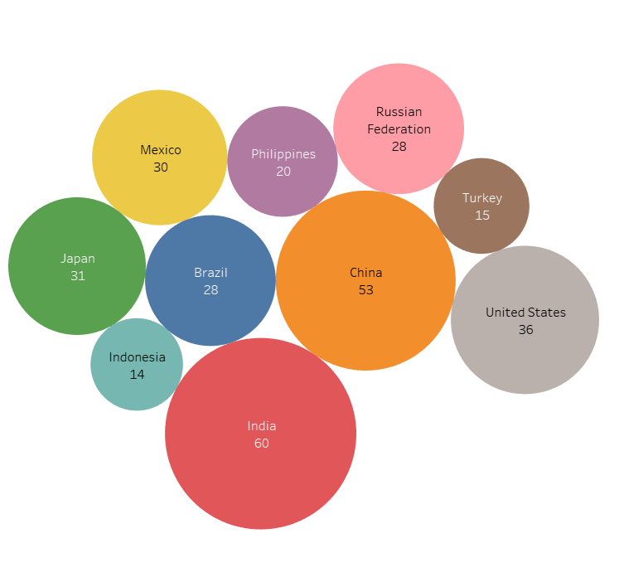
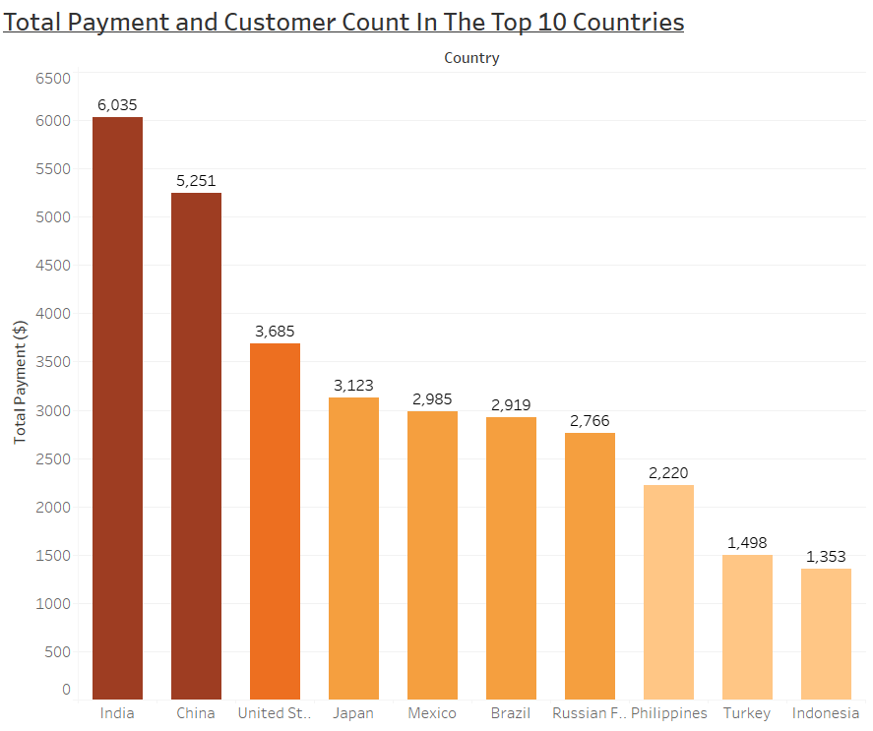

Top 10 Countries
The following chart shows the Top 10 countries with the highest number of customer.
Out of the top 10 countries the top 3 are:
India
China
United States

Slide 7
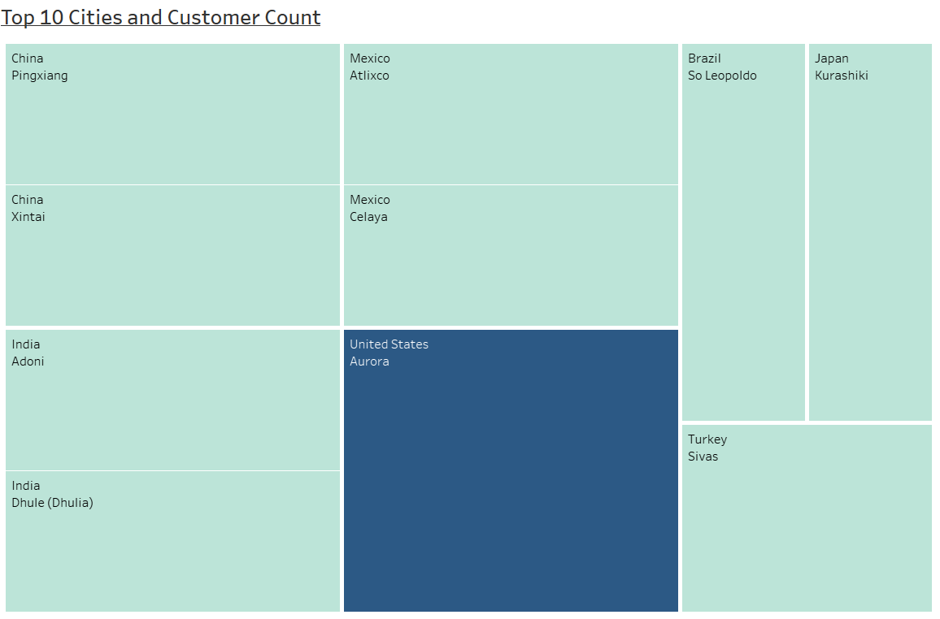
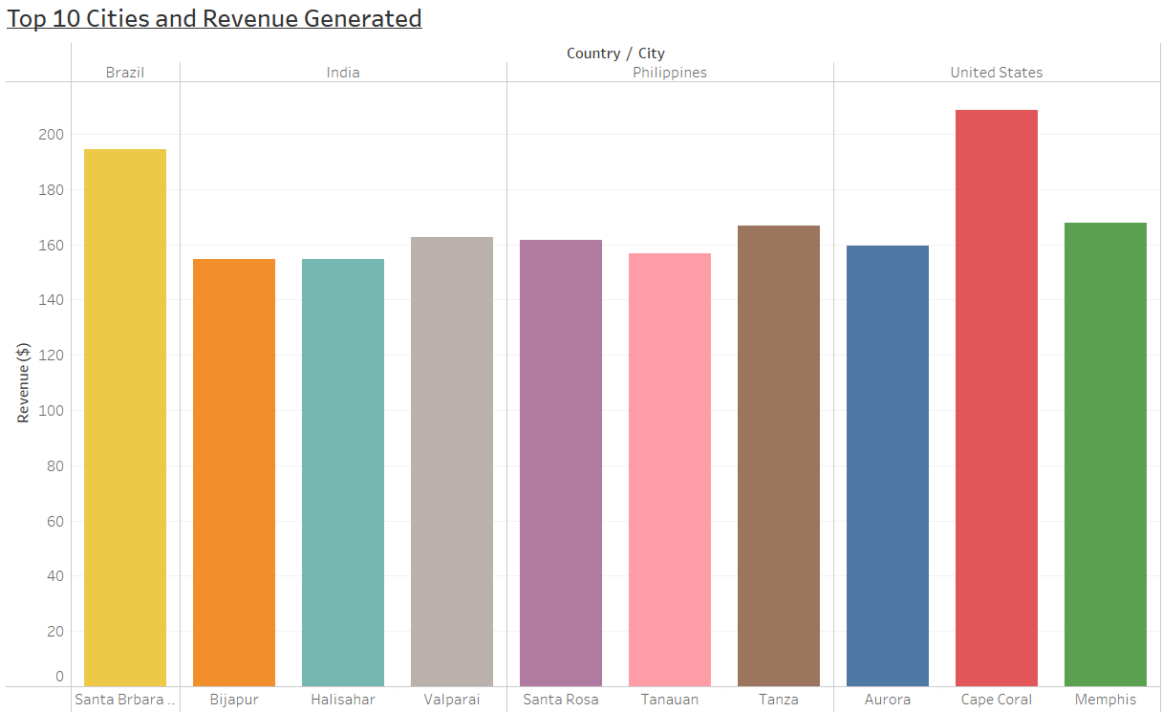

Top 10 Cities in Top 10 Countries
Above chart shows the top 10 cities within the top 10 countries in relation to the number of customers.
To look deeper in to the top 10 cities it is beneficial to look at the revenue generated. the outlook is different as the top 10 cities are from four countries as shown above.
Top 3 cities are Cape Coral, Santa Brbara dOeste and Tanza.

Slide 8
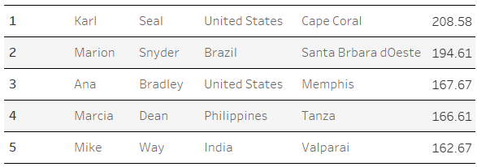
Top 5 Highest Paying Customers
The following table shows the top 5 customers who are the highest paying with Rockbuster stealth.
The customer team can use this data to reward the top 5 customers for their loyalty.

Slide 9
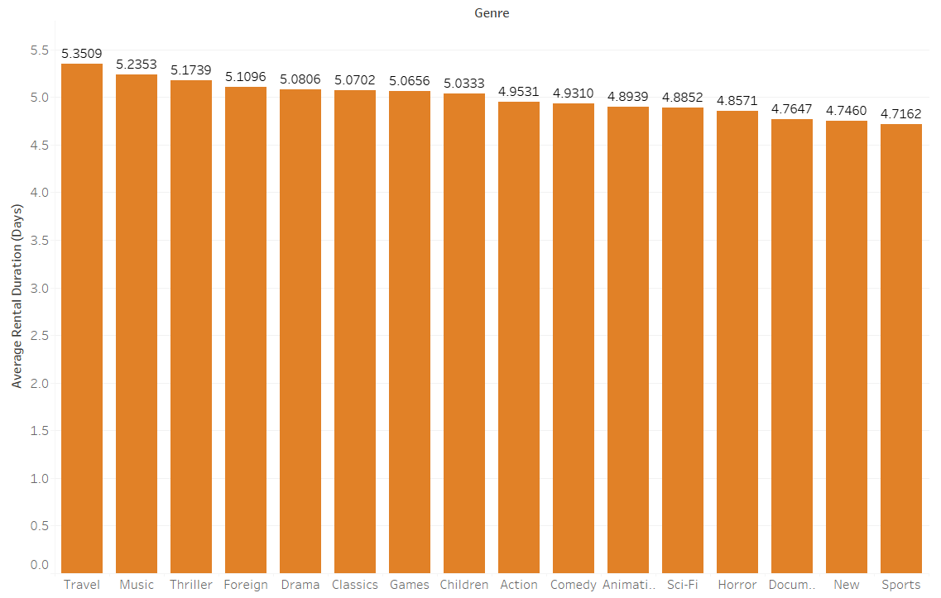
Average Rental Duration Of All Videos
Most films from all the genres are rented for 5 days on average.

Slide 10
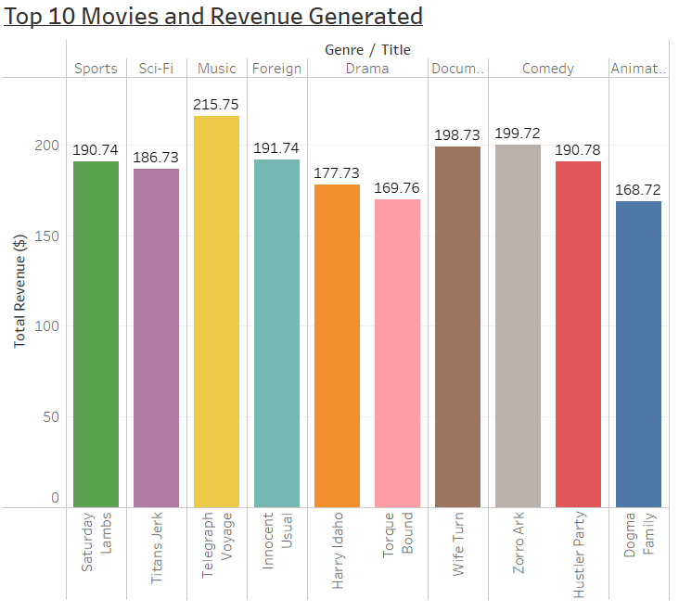
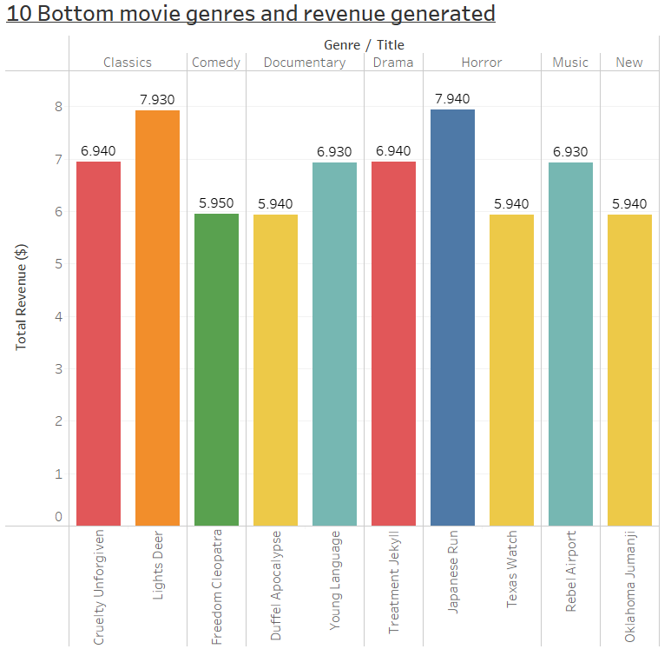
Movies Which Contributed The Most/Least Revenue Gain

Slide 11
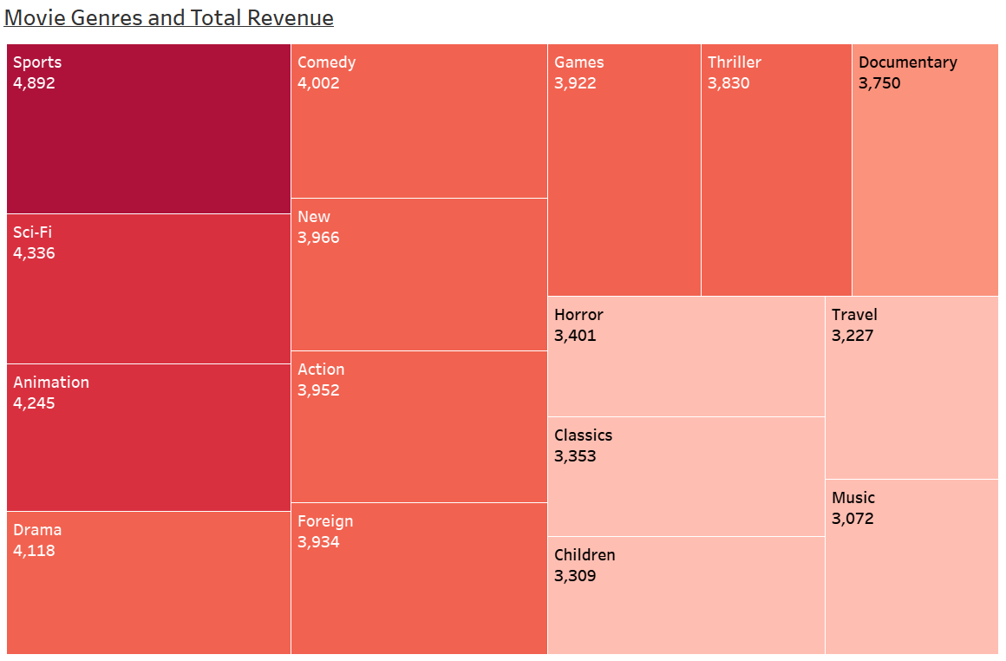

Movie Genres and Total Revenue
The top 5 genres which generate the most revenue are:
Sports
Sci-Fi
Animation
Drama
Comedy
Least revenue generated from the following genres:
Music
Travel
Children
Classics
Horror

Slide 12
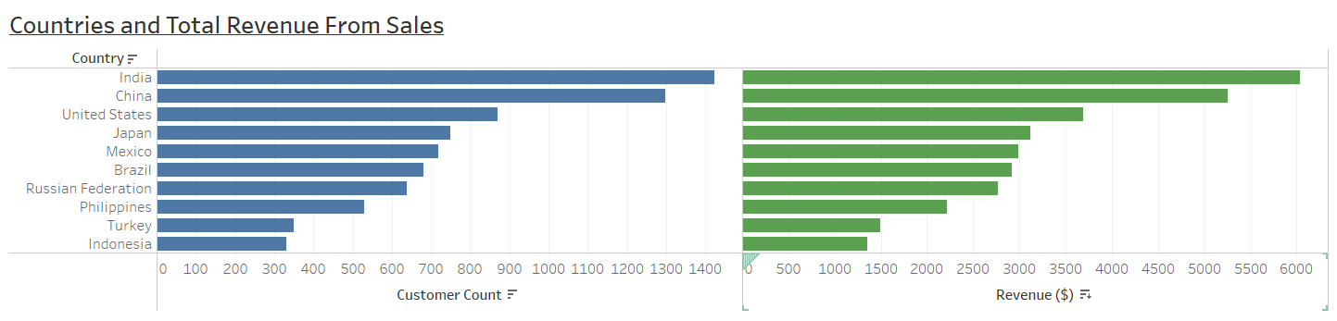
Sales Figures Between Geographic Regions
India, China and the United States have the highest number of customers that are generating the most revenue for Rockbuster Stealth’s rental market.

Slide 13
Conclusions/Recommendations
Rockbuster Stealth has customers all over the world with India, China and the United States having the highest customer count.
India, China and the United States also bring in the most revenue from their service.
Sports, Sci_Fi, Animation, Drama and Comedy are the top 5 film genres.
Rockbuster should focus on improving growth and sales in the countries not performing so well.
Marketing of film genres that have low revenue should be improved or focus more on the genres/movies doing well.
A rewards program would be a great idea not just for highest paying customers but all customers as an incentive to stream and use the online video service.
Tableau Link - https://public.tableau.com/app/profile/neha8185/viz/RockbusterStealthDataAnalysis_16314250639920/Rockbuster?publish=yes

